Slide 1

A Delphi Study of Research Priorities in Internet Safety
Davina Pruitt-Mentle, Ph.D.
Educational Technology Policy, Research and Outreach

Slide 2
The purpose of this study was to determine research priorities in Internet Safety Education

Slide 3
Round 1:
What do you envision as the primary issue in internet safety over the next five years?"
Round 1 statements were arranged in categories according to research focus.
Identified research statements and categories were then used to develop the Round 2 instrument.
32 expert particpants generated 245 responses → 72 statements under top ten categories
Notes:
Other question--“What should the research priorities for
cyberawareness/internet safety over the next five years be?”
30 expert participants generated 245 responses as to the research
needs in internet safety over the next five years. These responses
were reviewed by the researchers and consolidated so as to eliminate duplication.
Common research theme areas with similar responses were compiled with
as much of the respondent’s original wording as possible retained. In total, 72
statements were compiled and then categorized under 10 research priority
theme areas: Evaluation, External Influences, Current Issues, Learning, Models/
Strategies, Schools, Teachers, and Web-Based Environments.

Slide 4
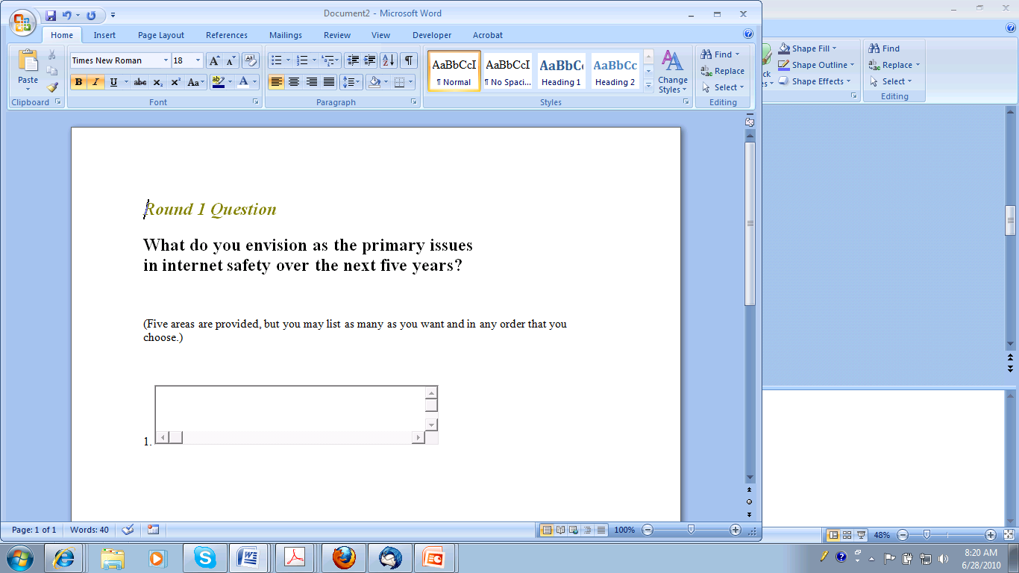
Notes:
Also asked Please provide any additional comments you may have concerning this study
and/or issues in educational technology in the box below.

Slide 5
Top Ten
Best Practices
Current Issues
Evaluation
Informal
Learning
Models/Strategies
Policies
Professional Development
Resources/Content
School/Formal

Slide 6
Round 2: Participants were asked to rate the research statements and categories
identified in Round 1 as to research need.
In addition to rating each research statement, they ranked the major research categories in order of their perceived importance. Once returned, descriptive statistics for the group ratings were calculated: mean, median, and standard deviation.
Notes:
For Round 2, panel members were asked to rate the 84 statements on a
Likert-type scale as to the degree of need (1 = No Need; 2 = Low Need; 3 = Medium
Need; 4 = High Need; 5 = Very High Need) for research that each statement
represents. Additionally, panel members were asked to prioritize the eight
research areas and encouraged to comment on any of the research statements
and/or areas. This was their first exposure to the research statements and areas
generated by the panel, and they were informed that they would have another
opportunity to assign ratings in Round 3. This round allowed them to assign
their initial perception of the need for the research knowing full well that they
would finalize their ratings based on their perceptions and the panel’s ratings in
the next round. In this way, a group consensus on research priorities could be
reached.

Slide 7
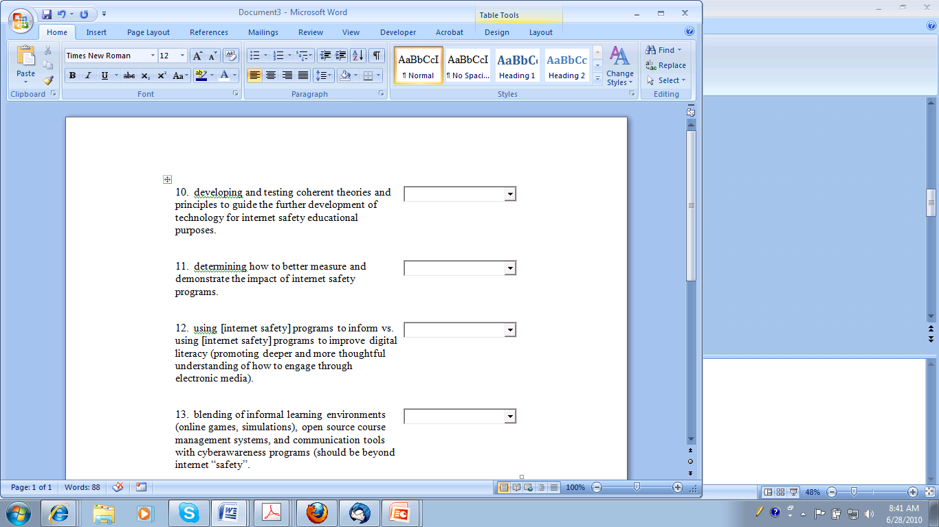
Evaluation
Rate importance 1-5
Notes:
1 = no importance low importance medium importance high importance very high importance

Slide 8
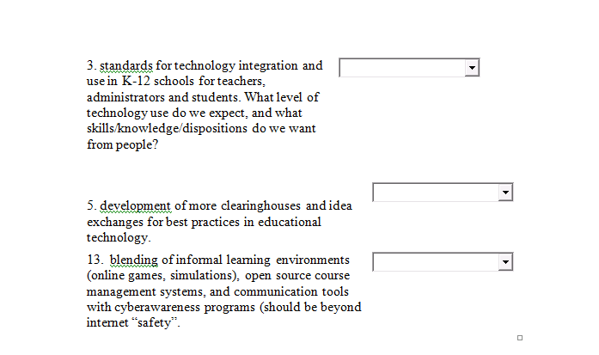
Best Practices

Slide 9
Round 3: Compiled the ratings of research statements and rankings of major research categories by the group in Round 2
Participants in Round 3 again ranked the major research categories as they did in Round 2, but this time descriptive information about how the group responded, as a whole, was provided.
Participating experts were asked to review each item, consider the group response and then re-rate the items, taking the information into account.
Notes:
The Round 3 questionnaire featured the panel ratings for the 84 statements
and eight research areas listing the mean, median, mode, and standard deviation.
For this round, panel members were asked to review the research priorities,
consider the group response and then re-rate the items, taking the information
into account. The eight priority areas were also reviewed and participants
re-ranked the areas from 1 to 8, with 1 being the top priority for research in
educational technology.

Slide 10
Rank Importance
Best Practices
Models/Strategies
Evaluation
Professional Development
Current Issues
Learning
School/Formal
Resources/Content
Informal
Policies

Slide 11
Questions
Davina Pruitt-Mentle, PhD
dpruitt@umd.edu
410 531 3910
Educational Technology Policy, Research and Outreach (ETPRO)

